Slide 1
An AR-Based Coaching System for Kabaddi Using Pose Estimation and LLM Feedback
Dr. T. Mala, Mohamed Ibrahim MS,
Professor, 2024178011

Slide 2
1. Introduction
Kabaddi is a high-intensity contact sport that requires explosive movements such as toe-touch, scorpion kick, hand touch, dubki, bonus step, and jump raid. Mastery of these skills demands precise timing, balance, and body coordination.
Players—especially beginners—often struggle to correctly learn these techniques because visual demonstrations are brief, coaches may not always be available, and players cannot see their own mistakes in real time.
This project introduces an AR-based Kabaddi Ghost Trainer, where a virtual avatar demonstrates reference moves and the system evaluates how closely the player replicates them using pose estimation, sequence comparison, and feedback generation.
The goal is to help Kabaddi learners practice independently, receive real-time correction cues, and improve movements with clear visual and data-driven guidance.

Slide 3
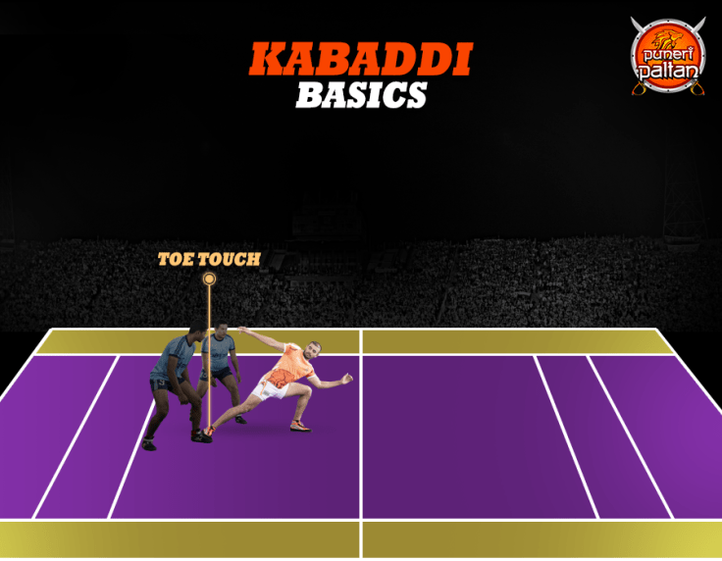
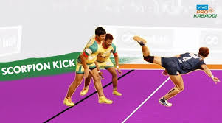
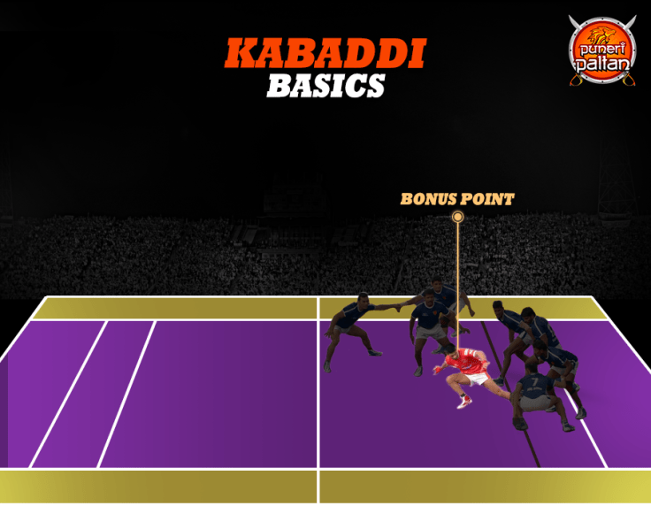
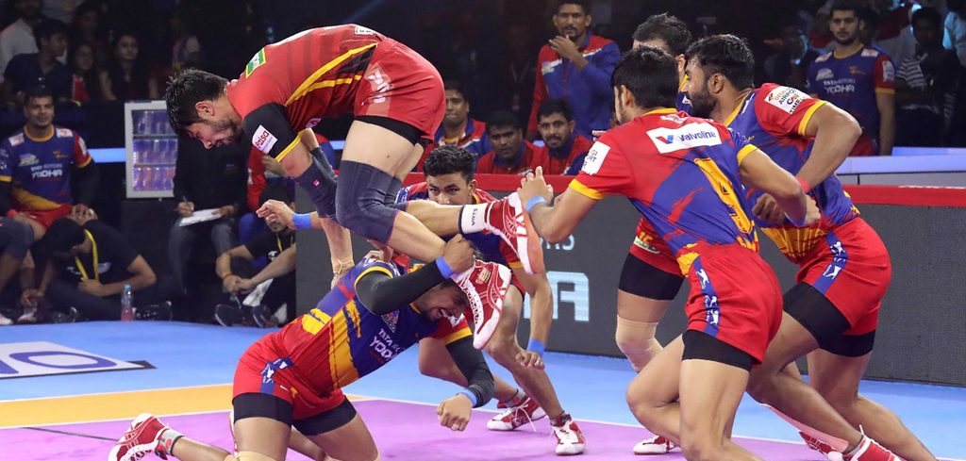
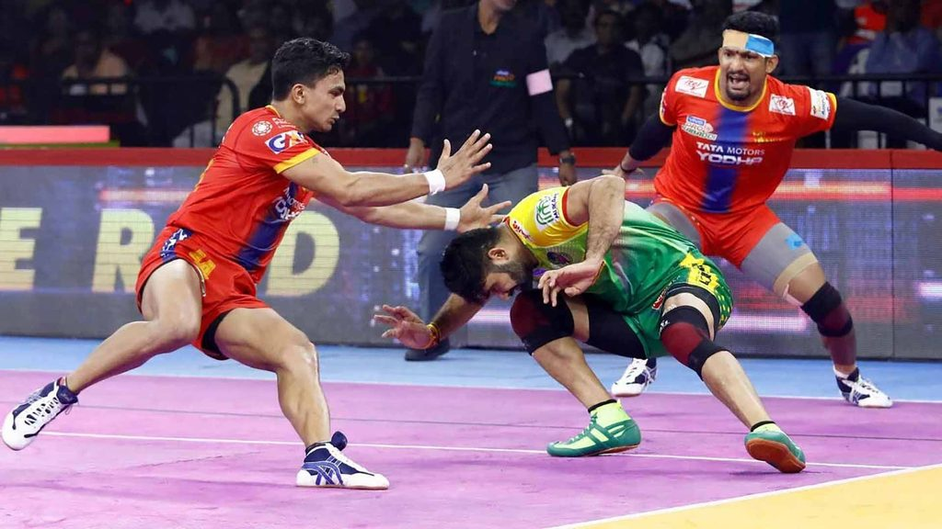
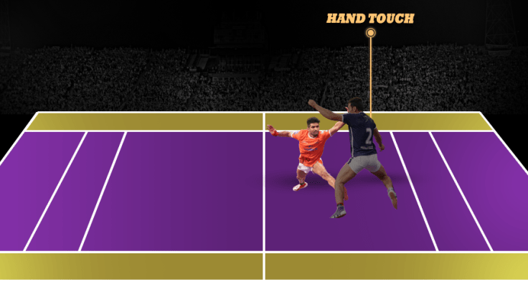
2. Introduction (Kabaddi skills)
Scorpion Kick
A backward high kick performed when facing away from the defender.
Toe Touch
A quick forward extension of the leg to tap the defender while maintaining balance.
Bonus Step
A long stride into the bonus line using body stretch and hip flexibility.
Jump Raid
A leap over defenders to avoid blocks while maintaining raid rhythm.
Dubki (Dive Escape)
A low-body dive used to slip under a defender’s block.
Hand Touch / Running Hand Touch
Fast hand extension during forward motion to tag defenders.

Slide 4
2. Problem Statement
Problem:
Kabaddi learners lack continuous visual guidance, real-time correction, and objective scoring, making it difficult to accurately replicate advanced movements.
Solutions Provided By the Proposed System:
AR Playback of Reference Moves
Players can view a 3D/AR “ghost” demonstrating the correct technique, allowing them to mimic the move with proper angle and timing.
Automated Movement Analysis
The user's captured movement is processed using pose estimation and compared with expert reference sequences.
Error Identification
Joint-wise mistakes, timing mismatches, and posture deviations are detected using similarity metrics and threshold-based classifiers.
LLM-Generated Coaching Feedback
The system produces simple, actionable instructions (“Raise your right elbow higher”, “Lean less forward”, etc.) to guide improvement.
Notes:
AR Playback of Reference Moves
Automated Movement Analysis
Error Identification
LLM-Generated Coaching Feedback

Slide 5
4. Literature Survey
Paper Title | Problem addressed | Positives / What they implemented | Negatives / Limitations | Result / metric
Aleksić, J., 2024. Markerless Pose Estimation vs. 3D Marker-Based Motion Capture: Application to Countermovement Jump (CMJ). Sensors. | Validates markerless pose estimation (MMPose) for biomechanical temporal analysis by comparing to gold-standard 3D MoCap. | Uses multi-camera markerless to estimate 3D joint angles; significant real-world validation. | Focused on jump task only; limited to specific motions; requires multi-view. | RMSE = 0.035 m correlation coefficient (r) of 0.992 and 0.993
Lin et al. (2020), Applied Sciences (MDPI) — Fall detection based on OpenPose. (MDPI) | Implementation of pose-estimation (OpenPose) + ML classifier for fall detection from video. | Concrete pipeline. Working of pose-based features in real scenes. | not sport-specific | RNN has the highest accuracy of 89% with LR=0.1 LSTM & GRU model accuracy of 98.3% with LR = 0.01
Deyzel et al. (2023), CVPR Workshops (CVSports) — One-shot skeleton-based action recognition on strength and conditioning exercises (CVPRW 2023). (CVF Open Access) | Practical skeleton-based recognition for exercise coaching with few-shot examples. | Implementation-focused: dataset of skeleton motion one-shot classification | Dataset covers conditioning exercises (not Kabaddi). | GCN metric = 46.2 Accuracy of 87.4%
Notes:
research works related to pose estimation, motion analysis, and skeleton-based learning.
The first paper by Aleksić (2024) validates markerless pose estimation by comparing it 3D motion capture systems. This work shows that markerless approaches can achieve high accuracy, making them suitable for real-world sports applications without expensive hardware.
The second paper by Lin et al. (2020) demonstrates a complete pose-based pipeline using OpenPose and machine learning classifiers. Although it is not sports-specific, it clearly establishes that pose-based features are reliable for movement analysis in real environments.
The third work by Devzel et al. (2023) focuses on skeleton-based action recognition using few-shot learning. This paper is important because it shows that skeleton representations are effective for learning and comparing movements, which directly motivates the similarity engine in my project.

Slide 6
4. Literature Survey cont.
Paper Title | Problem addressed | Positives / What they implemented | Negatives / Limitations | Result / metric
Long Liu et al. (2024), Journal of Intelligent & Systems / JISYS — Real-time pose estimation and motion tracking for sports performance (volleyball example). (ResearchGate) | Implementation of real-time pose estimation (OpenPose + tracking) and motion analytics in a sport scenario. | Integration of OpenPose + DeepSORT for multi-person tracking. handles occlusion & multi-player scenes. | Focused only on volleyball | Accuracy of 97.25% at 13.9 fps. Accuracy of 97.38% at 13.4 fps. Accuracy of 96.47% at 12.5 fps.
Ihara et al. (2024), arXiv / Mixed Reality Systems — Video2MR: Automatically generating mixed reality 3D instructional avatars by augmenting motion extracted from 2D videos. (arXiv) | Transforming 2D instructional video recordings into interactive 3D mixed reality motion instructions to assist physical training. | automatically extracts motion from 2D video and generates 3D MR avatars; highlights trajectory differences; supports time and spatial manipulation. augment existing instructional content into a 3D mixed reality format. | Requires specific hardware (HoloLens 2 + Azure Kinect); Focused on MR-only no full AR/AI training feedback loop; No personalized corrective feedback. | Baseball No.of Errors: 7 Accuracy of 93% Yoga No of Errors: 8 Accuracy of 89% Martial Arts No of Errors: 11 Accuracy of 86%
Notes:
Continuing the literature survey, this slide focuses on real-time tracking and AR/MR-based avatar systems.
Long Liu et al. (2024) propose a real-time pose estimation and tracking framework using OpenPose and DeepSORT. Their work highlights how pose tracking can be used effectively in sports environments, even with occlusions and multiple players.
Ihara et al. (2024) present a system that converts 2D instructional videos into mixed-reality 3D avatars. This paper is particularly relevant to my project because it demonstrates how motion extracted from videos can be transformed into interactive 3D avatars, which aligns closely with the idea of ghost trainers.
However, this system lacks an automated feedback loop, which my project aims to address.

Slide 7
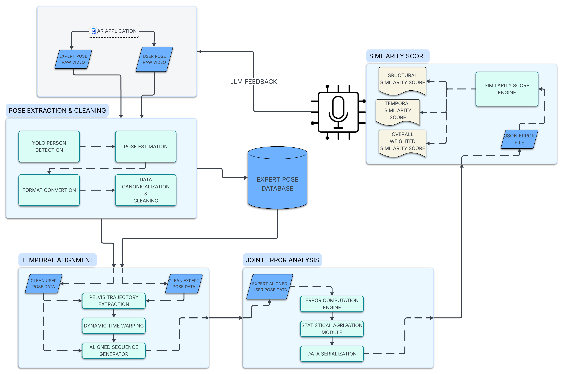
5. Overall System Architecture (High Level)

Slide 8
6. Modules
Pose Extraction & Cleaning
YOLO PERSON DETECTION (RAIDER)
POSE ESTIMATION
FORMAT CONVERTION
DATA CANONICALIZATION
TEMPORAL ALIGNMENT
PELVIS TRAJECTORY EXTRACTION
DYNAMIC TIME WARPING
ALIGNED SQUENCE GENERATOR
JOINT ERROR ANALYSIS
ERROR COMPUTATION ENGINE
STATISTICAL AGRIGATION MODULE
DATA SERIALIZATION
SIMLARITY SCORE
SIMILARITY SCORE ENGINE

Slide 9
6. Modules (POSE EXTRACTION & CLEANING)
Level 1 POSE EXTRACTION & CLEANING
MODULES :
YOLO PERSON DETECTION
POSE ESTIMATION
FORMAT CONVERTION
DATA CANONICALIZATION & CLEANING

Slide 10
6A – Module Overview & Block Diagram
Module:
YOLO-Based Person Detection and Tracking
Purpose:
tracks the active Kabaddi player (raider) from raw multi-person video.

Slide 11
6B – Algorithm Details
Algorithms Used
YOLOv8 – Object Detection
Role: Detect all human instances in each frame.
Result: B = { (x1, y1, x2, y2, confidence, class=person) }
ByteTrack – Multi-object Tracking
Role: Assign persistent IDs to detected persons across frames.
Result: Track ID → Sequence of bounding boxes over time
Motion-Based Raider Selection (Heuristic) “Cumulative Displacement Heuristic”
Formula:
motion_i = Σ || position_t − position_(t−1) ||
raider = argmax(motion_i)

Slide 12
6A – Algorithm Details cont.
Final OUTPUT:
Raider_BBoxes = {
frame_1: (x1, y1, x2, y2),
frame_2: (x1, y1, x2, y2),
...
}
Sample I/P, O/P:
Sample Input: raw video with 5–7 players visible
Sample Output (video with annotations)
Frame 45:
Raider ID = 3
Bounding Box = (420, 180, 610, 520)

Slide 13
7A – Module Overview & Block Diagram
Module Name
Single-Person Pose Estimation using MediaPipe BlazePose
Purpose
Extract of 2D skeletal keypoints of identified raider from video frames.
Converts pixel-level video data into structured pose coordinates.
Block Digram:
Raider Bounding Box Sequence
↓
Frame-wise Raider Cropping
↓
MediaPipe Pose Estimation (MP33)
↓
Raw Pose Keypoints (33 joints, normalized)

Slide 14
7B Algorithm Details
Algorithm Used
MediaPipe BlazePose (33-Keypoint Model)
Step 1: Raider-Locked Frame Cropping
Input: Frame + Raider Bounding Box
Padding: ±40 pixels
Clipping: Stay within frame bounds
Result: Tight region of interest (ROI) containing only the raider
Step 2: MediaPipe Pose Estimation
CNN-based pose estimation model
Trained for full-body human pose
Configuration Used
Videos (not static image)
Temporal landmark smoothing enabled
Confidence thresholds applied internally
Pose Representation
For each frame:
Pose_t = {
joint_0: (x, y),
joint_1: (x, y),
...
joint_32: (x, y)
}

Slide 15
7B Algorithm Details (cont)
Sample Input & Output
Sample Input
Frame 120
Raider Bounding Box = (420, 180, 610, 520)
Sample Output
Pose[120] =
[
(0.48, 0.12), # nose
(0.46, 0.10), # left eye
...
(0.52, 0.91) # right foot
]
Shape:
(33 joints × 2 coordinates)

Slide 16
8A Module Overview & Block Diagram
Module Name
Pose Format Conversion: MediaPipe-33 to COCO-17
Purpose
Convert MP33-keypoint pose representation into standard COCO-17 skeleton format for downstream analysis and compatibility with AR redndering.
Reduction of redundant joints and use widely accepted pose standard (COCO17).
Block diagram:
Raw MP33 Pose Data (Normalized)
↓
Joint Index Mapping
↓
Coordinate Transformation
↓
COCO-17 Pose Data (Pixel Space)

Slide 17
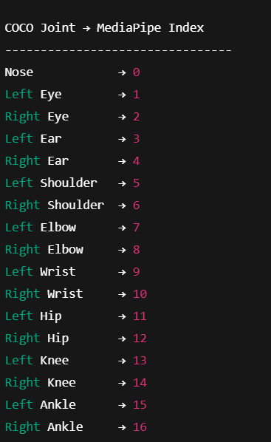
8B Algorithm Details
Algorithm Type
Deterministic Joint Index Mapping + Coordinate Transformation
(No learning, no estimation)
Step 1: Joint Index Mapping
Each COCO-17 joint is mapped to a specific MediaPipe landmark index.
Mapping Table (Fixed)

Slide 18
8B Algorithm Details (cont)
Step 2: Coordinate Transformation
Transformation Formula
For each joint:
x_pixel = bbox_x1 + lm.x × bbox_width
y_pixel = bbox_y1 + lm.y × bbox_height
Visibility Rule
If landmark visibility < 0.5:
(x, y) = NaN

Slide 19
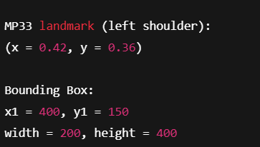
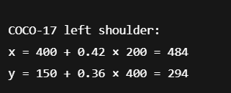
8B Algorithm Details (cont)
Sample Input & Output
Sample Input:
Sample Output:

Slide 20
9A Module Overview & Block Diagram
Module Name
COCO-17 Pose Canonicalization and Temporal Cleaning
Purpose
Convert raw COCO-17 pose to stable, normalized, and noise-free pose sequence for temporal alignment and error analysis.
Block diagram:
Raw COCO-17 Pose Sequence
↓
Temporal Interpolation
↓
Pelvis Centering
↓
Scale Normalization
↓
Outlier Suppression
↓
EMA Smoothing
↓
Cleaned & Normalized COCO-17 Pose

Slide 21
9B Algorithms Used
Type:
Deterministic Signal-Processing Pipeline (5 Steps)

